Slide 1
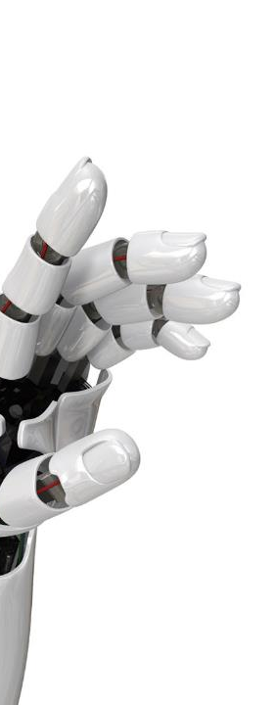

Codemasters for refugee talent
Shaping the workforce of the future with
Lesson 3

Slide 2


WHO ARE WE?
Lucas Meira
(Main instructor)
Role: Embedded Software Engineer
Hobbies: coding, cooking, traveling, dancing, gym
~3 years at ASML
From Brazil
Bram ter Huurne
( Support instructor)
Role: Metrology Engineer
Hobbies: cooking, running + CrossFit, traveling, camping
~4 years at ASML
From NL

Slide 3
How I use python
Control ASML machines
Move lenses, control light sources, move wafers 😎
Automation
Make my computer do boring tasks in an automated way
Makes my life easier at work
Desktop applications
Using libraries such as Qt to create desktop apps!
Dashboards & notebooks
Use marimo notebooks to visualize machine performance
Algorithm validation
Create, test and validate new algorithms running on ASML machines to improve performance

Slide 4
Agenda for session 3
Recap session 2
Code Comments
F-strings
Lists
Strings (just a little)
User input (just a little)
Exercise and questions

Slide 5
Recap
Printing to the screen
print("Hello World!")
Virtual Environments
Self contained, isolated projects
Variables
name = "Piet"
print("Hello\t", name)
Operations and casting
seconds = 73.0
print(f"{int(seconds/60)} minutes have passed.")
Notes:
Comparisons: == != > >= < <=

Slide 6
Recap
This is a floating-point division. It divides floats so first python casts 60 to float without telling you ☺. You can search the internet for other python operations such as integer- division // and modulo %
Operations and casting
seconds = 173.0
minutes = int(seconds/60)
This is a casting operation: we transform a float into an integer
Notes:
Comparisons: == != > >= < <=

Slide 7
COMMENTs
Python has commenting capability for the purpose of in-code documentation.
Comments start with a #, and Python will render the rest of the line as a comment:
age = 27 # This variable is used for tracking the age.
name = “Lisa”
age = age + 1
print (name, ‘is‘, age)
Important: Commented out code will not be executed!

Slide 8
EXERCISE
What is the final value of the variable age?
age = 27 # This variable is used for tracking the age.
name = “Lisa”
age = age + 3
#age = age + 1
30

Slide 9
Type conversion
+ operator pastes together two strings & can be very useful in building custom messages.
Example
! You can not sum strings and integers/floats.
To fix the error, you'll need to explicitly convert the types of your variables.
savings → 20 (int), result → 62.5 (float)
print("I started with $" + savings + " and now have $" + result + ". Awesome!")
In order to sum them together, you will need specifically str(), to convert a value into a string.
str(savings) → convert the integer savings to a string.
str(result) → convert the float to a string.
NOW you can sum
What will this print?
Is it correct?
! Remember
int(), float() and bool() similar to str() help you convert Python values into any type.

Slide 10
F-Strings
My favorite way of formatting strings in python is called an F-String. It is concise, fast and most importantly, easily readable.
To use it, put an uppercase or lowercase f before the opening quotation mark. After that, you can use your variable inside the string by putting them in between curly brackets (braces). Unlike the + operator you do not need to explicitly convert other types to string.
age = 27
name = “Lisa”
print (f“Hey {name}! You are {age} years old.”)
Hey Lisa! You are 27 years old.

Slide 11
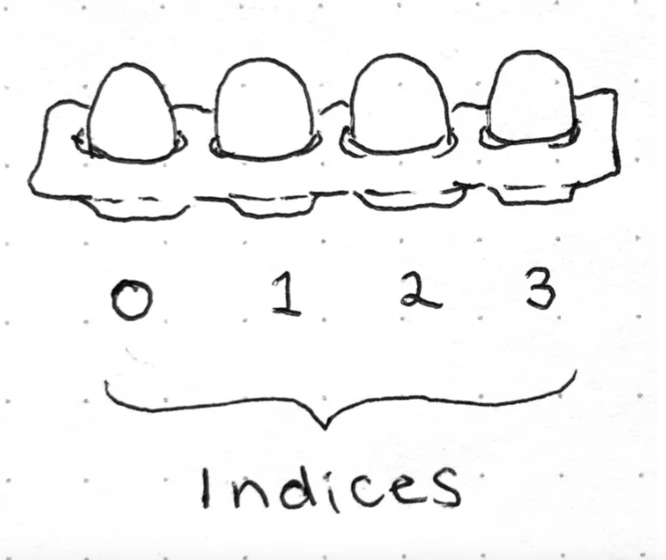
Python Lists
Python Lists are a type of Data Structure!
Data Structures are a core concept in Computer Science.
They allow us to group data in a cohesive way and apply algorithms on it.
Data structures are frequently inspired by physical arrangements in the real world!
For example, lists can be seen as an egg tray
Notes:
Comparisons: == != > >= < <=

Slide 12


Python Lists
Often, you’ll want to work with many data points. Imagine you work for the Netherlands Forecast Agency and you want to keep track of the max temperature every day of a given month. It would be inconvenient to use one variable for each day of the month. Instead, you can make a list for the month and use each place in the list to save the max temp. of a day.
January_1 = 5
January_2 = -1
January_3 = 3
January_4 = 4
January_5 = 3
January_6 = 2
January_7 = 1
January_8 = 0
January_9 = 2
January_10 = 3
…
January_29 = 6
January_30 = 5
January_31 = 4
A list is a compound data type; you can group values together by using square brackets [] and separating them by comma.
January = [5, -1, 3, 4, 3, 2, 1, 0, 2, 3, 4, 5, 6, 7, 6, 5, 4, 3, 2, 1, 0, 1, 2, 3, 4, 5, 6, 7, 6, 5, 4]
Notes:
Comparisons: == != > >= < <=

Slide 13
Python lists
Tip: have the students write down their answers. Then check which statements most students got right/wrong.
If a lot of students gave the wrong answer for a particular line of code, it’s worth spending some time going over that line again.
Examples of lists
[1,3,4,2] # a list of integers
[[1,2],[3,4,5],[9]] # what about this one?
[1+2, "a"*3] #
[0] * 100 #

Slide 14
Python lists
Tip: have the students write down their answers. Then check which statements most students got right/wrong.
If a lot of students gave the wrong answer for a particular line of code, it’s worth spending some time going over that line again.
Examples of lists
[1,3,4,2] # a list of integers
[[1,2],[3,4,5],[9]] # a list of lists of integers
[1+2, "a"*3] # what about this one?
[0] * 100 #

Slide 15
Python lists
Tip: have the students write down their answers. Then check which statements most students got right/wrong.
If a lot of students gave the wrong answer for a particular line of code, it’s worth spending some time going over that line again.
Examples of lists
[1,3,4,2] # a list of integers
[[1,2],[3,4,5],[9]] # a list of lists of integers
[1+2, "a"*3] # a list of various types
[0] * 100 # what about this one?

Slide 16
Python lists
Tip: have the students write down their answers. Then check which statements most students got right/wrong.
If a lot of students gave the wrong answer for a particular line of code, it’s worth spending some time going over that line again.
Examples of lists
[1,3,4,2] # a list of integers
[[1,2],[3,4,5],[9]] # a list of lists of integers
[1+2, "a"*3] # a list of various types
[0] * 100 # a list of 100 zeros

Slide 17
Python lists
Tip: have the students write down their answers. Then check which statements most students got right/wrong.
If a lot of students gave the wrong answer for a particular line of code, it’s worth spending some time going over that line again.
Read an element of a list by index (position)
January = [5, -1, 3, 4, 3, 2, 1, 0, 2, 3, 4, 5, 6, 7, 6 …
print(f"The max. temp. on 3rd of January was {January[2]}.")

Slide 18
Python lists
Tip: have the students write down their answers. Then check which statements most students got right/wrong.
If a lot of students gave the wrong answer for a particular line of code, it’s worth spending some time going over that line again.
Read an element of a list by index (position)
January = [5, -1, 3, 4, 3, 2, 1, 0, 2, 3, 4, …, 6, 5, 4]
print(f"The max. temp. on 3rd of January was {January[2]}.")
>> The max. temp. the 3rd of January was 3
Why index 2 for 3rd of January?

Slide 19
Python lists
Read an element of a list by index (position)
List indices go from 0 to length-1
January = [5, -1, 3, 4, 3, 2, 1, 0, 2, 3, 4, …, 6, 5, 4]
print(f“Temperature the last day was {January[31]}.")
Traceback (most recent call last):
File "c:\Users\rmonti\Downloads\CodeMasters2025\temperatures.py", line 7, in <module>
print(f"Temperature the last day was {January[31]}.")
~~~~~~~^^^^
IndexError: list index out of range
Position 31 in the list is index 30

Slide 20
Python lists BONUS!
Read an element of a list by index (position) BONUS
January = [5, -1, 3, 4, 3, 2, 1, 0, 2, 3, 4, …, 6, 5, 4]
print(f“Temperature the last day was {January[-1]}.")
>> Temperature the last day was 4.

Slide 21
Python lists BONUS!
Read an element of a list by index (position)
tshirtSize = ['xs', 's', 'm', 'l', 'xl']
# position 1st 2nd 3rd 4th 5th
# index --> 0 1 2 3 4
# index <-- -5 -4 -3 -2 -1
print("Is index 2 the same as -3? ", tshirtSize[2] == tshirtSize[-3])

Slide 22
Python lists
Tip: have the students write down their answers. Then check which statements most students got right/wrong.
If a lot of students gave the wrong answer for a particular line of code, it’s worth spending some time going over that line again.
Modify an element of a list by index (position)
January = [5, -1, 3, 4, 3, 2, 1, 0, 2, 3, 4, 5, 6, 7, 6 …
January[2] = 0
print(f"The max. temp. on 3rd of January was {January[2]}.")
Remember that ‘=’ means assignment

Slide 23
Python lists
Tip: have the students write down their answers. Then check which statements most students got right/wrong.
If a lot of students gave the wrong answer for a particular line of code, it’s worth spending some time going over that line again.
Modify an element of a list by index (position)
January = [5, -1, 3, 4, 3, 2, 1, 0, 2, 3, 4, 5, 6, 7, 6 …
January[2] = 0
print(f"The max. temp. on 3rd of January was {January[2]}.")
>> The max. temp. the 3rd of January was 0

Slide 24
More operations on lists
Python has set of built-in methods which you can use to access or manipulate the content of a list:
mylist = [0,0,0]
length = len(mylist) # returns the length of mylist >> 3
mylist.insert(1,'x') # inserts element 'x' at position pos 1 of mylist
mylist.remove('x') # removes first occurrence of elem in list mylist
Q1: what do you find different between len on one hand and insert and remove on the other hand?
Q2: What will the following command print? print([1,2,3].remove(2))
[1,2]
[1,3]
None of the above
Commands on objects
Reads mylist to calculate a value and returns that value
Modify mylist and return None

Slide 25
More operations on lists
List of floats
We cast the integer length to a string so we can concatenate it to the rest of the message
Example on list operations:
arrivalTime = [9.42, 8.15, 8.55, 9.07, 8.35]
length = len(arrivalTime)
message = "We have recorded " + str(length) + " arrival times."
print(message)
earliest = min(arrivalTime)
latest = max(arrivalTime)
print(f"The earliest recorded arrival time was {earliest}, while the latest was {latest}.")
Gives you the maximum value in a list
Formatted strings do the casting themselves. Notice that earliest and latest are floating point numbers.

Slide 26
More operations on lists
Concatenating lists (putting them together)
head = ['Hello']
tail = [' ', 'World', '!']
hello_world = head + tail
print(hello_world)

Slide 27

Python lists
Tip: have the students write down their answers. Then check which statements most students got right/wrong.
If a lot of students gave the wrong answer for a particular line of code, it’s worth spending some time going over that line again.
Let's create a simple Python program to track the heights of everyone in your family. We'll use a Python list to store all the heights efficiently. For this exercise, heights will be pre-defined instead of being inputted by the user.
Exercise
Create a Python list named "family_heights" and initialize it with the heights of your family members.
Calculate the total number of family members and assign it to a variable called "num_family_members".
Print the total number of family members and the list of heights.
Calculate and print the average height of the family.
Finally, find and print the tallest and shortest family members along with their heights.
Tips: Just as we have a method len to measure a list, you can try using other methods such as sum, min and max to write your code.
Example

Slide 28
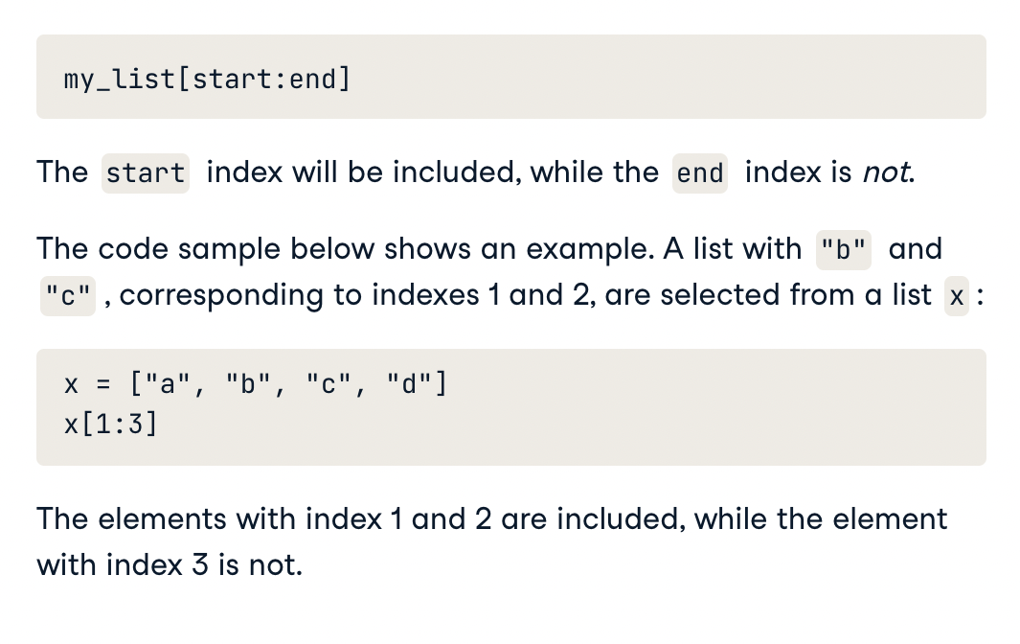
Bonus: Slicing and dicing
It's also possible to slice your list, which means selecting multiple elements from your list.
Remember
If you don’t specify the start, python assumes you want to start from the first element.
If you don’t specify the end, it assumes you want to go all the way to the end of the list.
BONUS: try these and explain what is happening
abc = ['a', 'b', 'c', 'd', 'e',]
print(abc[0:5:2])
print(abc[0:-1:2])
print(abc[0::2])
Notes:
if/elif/else

Slide 29

Strings are also sequences
Strings are not lists but they are also sequences. They share some of the same behaviours as lists. However, Strings are immutable.
greetings = "Hello world"
print(greetings[0]) # can read by index
greetings[0] = "h" # strings are immutable
greetings.insert(-1, "!") # strings are immutable, not every list method applicable
print(greetings.lower()) # specific inbuilt methods (also .upper() .startswith() etc.)
print(greetings.upper()) # returns a NEW string
print(greetings) # same old string from first line
print(greetings + "!") # you can concatenate strings easily

Slide 30
CONSOLE input
You can interact with your code using the console (terminal). For this, you can use the input function:
name = input("What is your name?")
print(f"Hi {name}, nice to see you here!")
This message will be printed in the console.
Input will wait for you to write your answer on the console and press ENTER
After you hit ENTER, the code will continue to execute, and your answer will be saved in the variable you assigned it to (name in this case)
Notes:
if/elif/else

Slide 31
CONSOLE input
In python user input can be captured using built-in input function.
selection = input(
"""Please select your ice-crem flavor:
1) Chocolate
2) Strawberry
3) Smurf
""")
print(f"You have selected {selection}")
“““ Like this, I can write
multiline strings without
having to use \n
”””
The input function returns a string even if it’s a number, so we need to type cast it explicitly.
number = input("Choose a number between 1 and 100\n>> ")
print(f"I chose {number + 1} so I win!")
Notes:
if/elif/else

Slide 32
CONSOLE input
In python user input can be captured using built-in input function.
selection = input(
"""Please select your ice-crem flavor:
1) Chocolate
2) Strawberry
3) Smurf
""")
print(f"You have selected {selection}")
The input function returns a string even if it’s a number, so we need to type cast it explicitly.
number = input("Choose a number between 1 and 100\n>> ")
print(f"I chose {int(number) + 1} so I win!")
Notes:
if/elif/else

Slide 33
Question time

Slide 34
EXERCISE
Let's create a simple Python program to track the heights of everyone in your family. We'll use a Python list to store all the heights efficiently. For this exercise, heights will be pre-defined instead of being inputted by the user.
Instructions:
Create a list called numbers containing the height of 5 family members
Print the list.
Print the length of the list.
Print the first element of the list.
Print the last element of the list.
Print the sublist containing the second and third elements of the list.
Modify the fourth element of the list to be 30.
Print the modified list.
34
Notes:
Modified list: [10, 15, 30, 25]

Slide 35
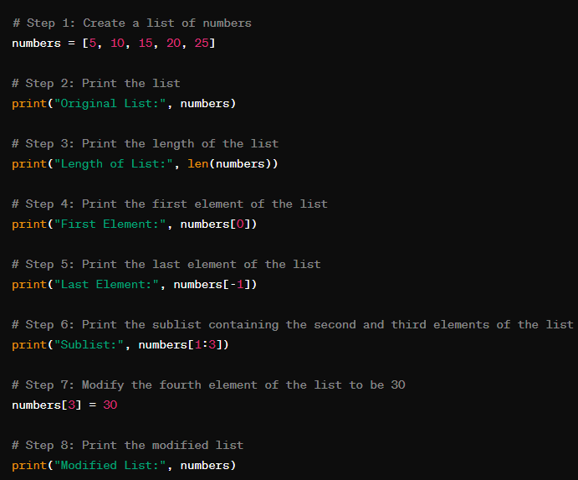

Slide 36
EXERCISE
Let's create a simple Python program to track the heights of everyone in your family. We'll use a Python list to store all the heights efficiently. For this exercise, heights will be pre-defined by you in centimeters.
Instructions:
Create a Python list named "family_heights" and initialize it with the heights of your family members.
Calculate the total number of family members and assign it to a variable called "num_family_members".
Print the total number of family members and the list of heights.
Calculate and print the average height of the family.
Finally, find and print the tallest and shortest family members along with their heights.
Tips: Just as we have a method len to measure a list, you can try using other methods such as sum, min and max to write your code.
36

Slide 37
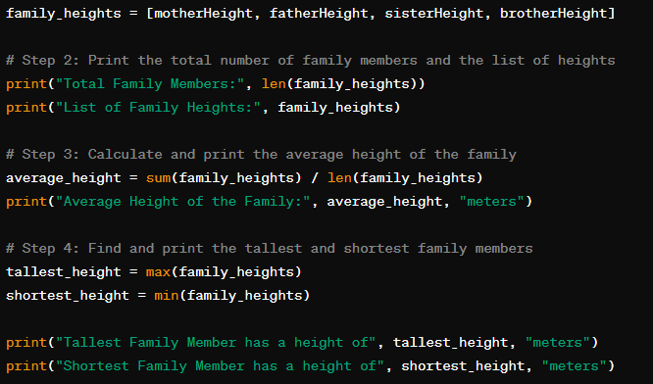

Slide 38

SEE YOU NEXT WEEK!

